Slide 1
6.006 Introduction to Algorithms
Spring 2021
Lecture 8
Priority Queues, Heaps, Heap Sort
Nir Shavit

Slide 2
Menu
Priority Queues
Heaps
Heapsort

Slide 3
Priority Queue
A data structure implementing a set S of elements, each associated with a key, supporting the following operations:
insert(S, x) :
insert element x into set S
max(S) :
return element of S with largest key
delete_max(S) :
return element of S with largest key and remove it from S

Slide 4
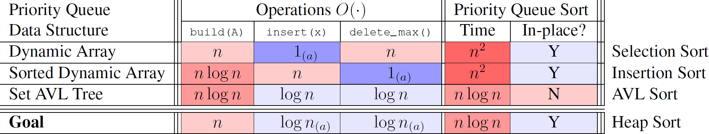

Slide 5
Heap
Dict: a group of things placed,
thrown, or lying one on another;
Implementation of a priority queue
An array, visualized as a nearly complete binary tree
Max Heap Property: The key of a node is ≥ than the keys of its children
(Min Heap defined analogously)
16
1
2
3
14
10
5
6
7
1
2
3
4
5
6
7
8
9
10
4
8
7
9
3
16
14
10
8
7
9
3
2
4
1
8
9
10
2
4
1
All my arrays start at index 1

Slide 6
Heap as a Tree
root of tree: first element in the array, corresponding to i = 1
parent(i) =i/2: returns index of node's parent
left(i)=2i: returns index of node's left child
right(i)=2i+1: returns index of node's right child
16
1
2
3
14
10
5
6
7
1
2
3
4
5
6
7
8
9
10
4
8
7
9
3
16
14
10
8
7
9
3
2
4
1
8
9
10
2
4
1
No pointers required! Height of a binary heap is O(lg n)

Slide 7
Operations with Heaps
Heap Operations
build_max_heap :
produce a max-heap from an unordered array
max_heapify :
correct a single violation of the heap property in a subtree at its root
insert, delete_max, heapsort

Slide 8
Max_heapify
Assume that the trees rooted at left(i) and right(i) are max-heaps
If element A[i] violates the max-heap property, correct violation by “trickling” element A[i] down the tree, making the subtree rooted at index i a max-heap
In every trickling step bring up A[i]’s largest child, that is, the max among A[left(i)] and A[(right(i)]

Slide 9
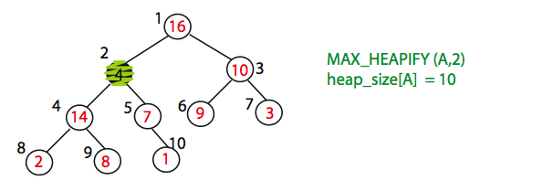
Max_heapify (Example)
Node 10 is the left child of node 5 but is drawn to the right for convenience

Slide 10
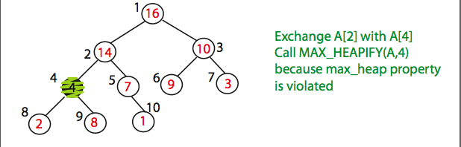
Max_heapify (Example)

Slide 11
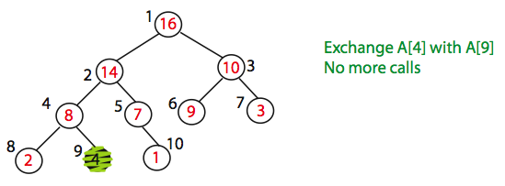
Max_heapify (Example)
Time=?
O(log n)

Slide 12
Max_Heapify Pseudocode
l = left(i)
r = right(i)
if (l <= heap-size(A) and A[l] > A[i])
then largest = l else largest = i
if (r <= heap-size(A) and A[r] > A[largest])
then largest = r
if largest = i
then exchange A[i] and A[largest]
Max_Heapify(A, largest)

Slide 13
Build_Max_Heap(A)
Converts A[1…n] to a max heap
Build_Max_Heap(A):
for i=n/2 downto 1
do Max_Heapify(A, i)
Why start at n/2?
Because elements A[n/2 + 1 … n] are all leaves of the tree
2i > n (i.e. no children), for i > n/2 + 1
Time=?
O(n log n)
via simple analysis

Slide 14
Build_Max_Heap(A) Analysis
Converts A[1…n] to a max heap
Level k
O(k)
Level 2
Build_Max_Heap(A):
for i=n/2 downto 1
do Max_Heapify(A, i)
Level 1
O(1)
Level 0
Observe however that Max_Heapify takes O(1) for
time for nodes that are one level above the leaves, and
in general, O(k) for the nodes that are k levels above the
leaves.
We have n/4 nodes with level 1, n/8 with level 2,
and so on till we have one root node that is lg n levels
above the leaves.

Slide 15
Build_Max_Heap(A) Analysis
Converts A[1…n] to a max heap
Build_Max_Heap(A):
for i=n/2 downto 1
do Max_Heapify(A, i)
Total amount of work in the for loop can be summed as:
n/4*(1*c) + n/8*(2*c) + n/16*(3*c) + … + 1*(lg n – 1)c
Setting n = 2^{k} and simplifying we get:
c*2^{k}(1/2² + 2/2³ + 3/2⁴ + … (k – 1)/2^{k} )
The term is brackets is bounded by a constant!
This means that Build_Max_Heap is O(n)

Slide 16
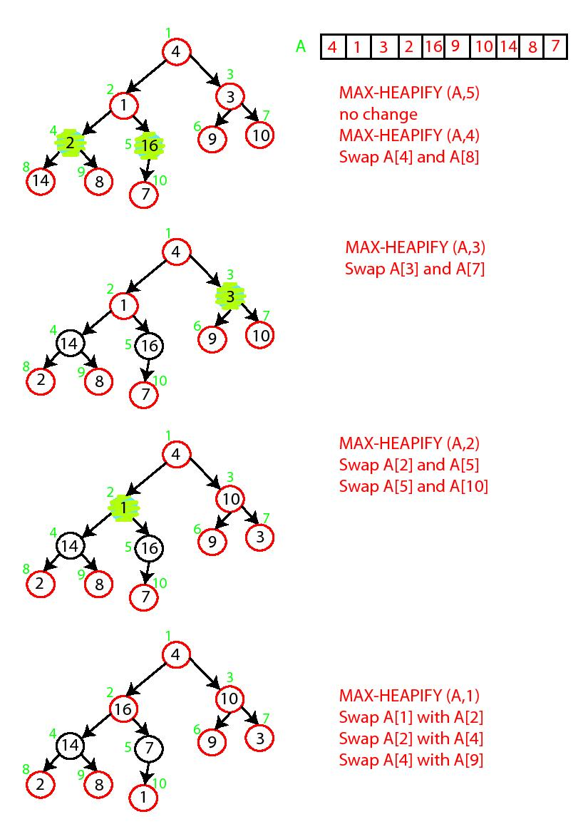
Build-Max-Heap Demo

Slide 17
Build-Max-Heap Demo

Slide 18

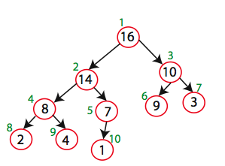
Build-Max-Heap
16 14 10 8 7 9 3 2 4 1

Slide 19
Heap-Sort
Sorting Strategy:
1. Build Max Heap from unordered array;
2. Find maximum element A[1];
3. Swap elements A[n] and A[1]:
now max element is at the end of the array!
4. Discard node n from heap
(by decrementing heap-size variable)
5. New root may violate max heap property, but its children are max heaps. Run max_heapify to fix this.
6. Go to Step 2 unless heap is empty.

Slide 20
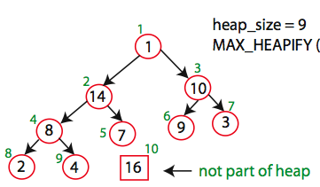
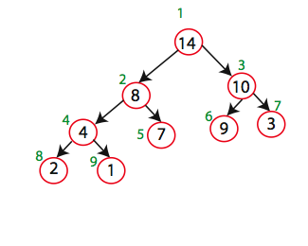
Heap-Sort Demo
Swap A[10] and A[1]
Max_heapify(A,1)

Slide 21
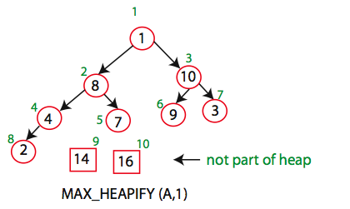
Heap-Sort Demo
Swap A[9] and A[1]

Slide 22
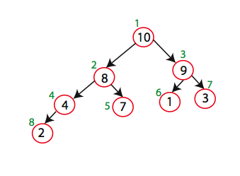
Heap-Sort Demo

Slide 23
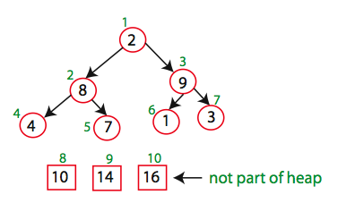
Heap-Sort Demo
Swap A[8] and A[1]

Slide 24
Heap-Sort
Running time:
after n iterations the Heap is empty
every iteration involves a swap and a max_heapify operation = O(log n) time
Overall O(n log n)

Slide 25


